Slide 1
GREEN CLOUD COMPUTING
-A Data Center Approach

Slide 2
E-Journey
Basics of Green & Cloud Computing
Green Cloud Computing-A Data Center Perspective
Green Cloud Computing in Developing Regions
Balancing Energy in Data Centers
Energy Aware Data Center Management
Power Usage Effectiveness
Case Studies :- Senegal & South Africa
Indian Scenario
Go Green
References
Notes:
Contents of the Presentation:
The reason I have called it as E-Journey(Environmental-Journey) is because we will come full cycle at the end of this presentation.

Slide 3

Green Computing
Study and Practice of designing, manufacturing, using and disposing computing resources with minimal environmental damage
Energy Star, OECD
Product Longevity- Carbon Footprint
Steps : -
Algorithmic Efficiency
Resource Allocation
Virtualization-IBM, Intel, AMD
Terminal Servers-thin clients, Terminal Services, LTSP
Power Management- APM ,ACPI, undervolting(SpeedStep)
“Data Center” Power-Google Inc.
Material Recycling
Notes:
Definition of Green Computing as given by San Murugesan
The Organization for Economic Cooperation and Development(OECD) has published a survey of over 90 government and industry initiatives on "Green ICTs", i.e. information and communication technologies, the environment and climate change. The report concludes that initiatives tend to concentrate on the greening ICTs themselves rather than on their actual implementation to tackle global warming and environmental degradation
APM-Advanced Power Management
ACPI-Advanced configuration Power Interface-Predecessor to APM
SpeedStep-Intel’s Technology

Slide 4



Cloud Computing
Virtualized Computing Platform
Scalable use of computing resources
Pay-per-Use concept
“Passive” Consumers to “Prosumers”
Amazon, Google, Microsoft
Service Levels : -
PLATFORM
AS A SERVICE-Build on it
SOFTWARE
AS A SERVICE-Consume it
INFRASTRUCTURE
AS A SERVICE-Migrate to it
Notes:
Cloud Computing-
When talking about a cloud computing system, it's helpful to divide it into two sections: the front end and the back end. They connect to each other through a network, usually the Internet. The front end is the side the computer user, or client, sees. The back end is the "cloud" section of the system.

Slide 5
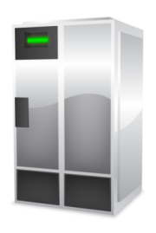
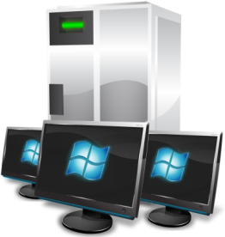


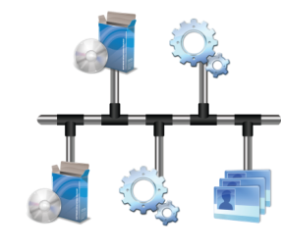


Cloud Platform
Accessed via the internet
Low IT skill to implement
Third party provider
Usage based economics (CapEx to OpEx)
Notes:
Transition from:
Capital Based Expenditure(CapEx) to Operation Based Expenditure(OpEx)

Slide 6
Green Cloud Computing -A Data Center Perspective
Supply Chain Energy Usage
“Green” Data Centers
Steps : -
Diagnose opportunities & problems
Measure & Manage
Cool-”blanking panels”
Virtualize
Build
Server Virtualization
Energy-Aware Consolidation
Notes:
Steps mentioned here are according to the IBM’s “Big Green” Approach to Data Centre Energy Energy Efficiency
Virtualization continues to be one of the hottest green data center topics. Many current server CPU utilization rates
typically hover between 5% and 15%. Direct-attached storage utilization sits between 20% and 40%, with network storage
between 60% and 80%. Virtualization can increase hardware utilization by five to 20 times and allows organizations to
reduce the number of power-consuming servers. Cloud computing is the “ultimate” in virtualization

Slide 7
Green IT in developing regions -Introduction
Development of ICT
Moving Processor and Data closer to the User
Public Policy measures-Germany example, PPP
Locating Data Centers in the developing world
Economic Growth
Notes:
Moving processing and data closer to the user in the developing region plays an import role on three fronts;
Keeps needed jobs and systems ICT people in region,
2. Sidesteps high telecommunication bandwidth costs and network latency issues in and out of the region and
3. Quality of service: in region computing can remove a major points of network failure and potential bandwidth bottlenecks
PPP-Public Private Partnerships
Germany Example : Germany serves as an excellent example, as the country has become the world leader in solar power, with
half the world’s installations within its borders, thanks to policies including aggressive renewable energy subsidies and
large sums of money devoted to research.

Slide 8
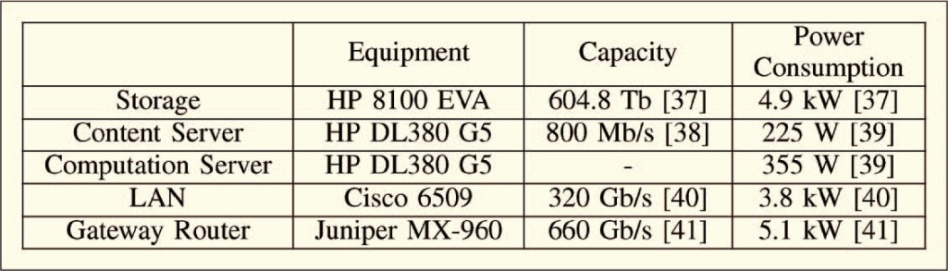
Balancing Energy in Data Centers
Components : - Data Storage, Servers, LAN
Power Consumption
Hard Disk Arrays-Long term Storage
Server Consolidation
Notes:
The power consumption data for each server was obtained by first calculating the maximum power using HP’s power calculator , then
following the convention that average power use for midrange/high-end servers is 66% of maximum power.
Hard disk arrays include supporting functionality such as cache memories, disk array controllers, disk enclosures, and redundant power supplies. In a cloud computing data center, all the storage space in the data center is consolidated and hard disk usage is centrally coordinated.
Through server virtualization/consolidation, a very large number of users can share a single server, which increases utilization and in turn reduces the total number of servers required. Users do not have or need any knowledge of the tasks being performed by other
users and utilize the server as though they are the only user on the server. During periods of low demand, some of
the servers enter a sleep mode which reduces energy consumption.

Slide 9
Energy Aware Data Center Management
OLPC Project
Low Power Computing Platforms- Modern Data Centers
“Managing” computing load
Prioritization
Virtualization technologies for Data Centers
Cooling Data Centers- “42%”
Used in Solar PV Systems
Notes:
OLPC-One Laptop Per Child Project
Examples such as 100$ laptop in US or Aakash Tablet PC launched in India
These signify the innovations under adverse conditions.
The first technological innovation highlighted herein focuses on the viability of small cloud computing farms deployed in small-scale data centers using low power processors like the Intel Atom, Arm Cortex and Via Nano. These central processing units (CPUs), originally designed for use in netbooks, require only 2 to 10 watts versus 80 to 160 watts for the processors typically used in data center servers. These low-power processors also have quiescent states that consume little energy, unlike the standard data center CPU that consumes 50% of its peak energy even while in idle mode.
Microsoft Research has an organizational division called Cloud Computing Futures (CCF), focused on reducing the operational costs of data centers
and increasing their adaptability and resilience to failure.
Among their findings: “these processors offer substantial fractions (33 percent to 50 percent) of the performance of
the high-performance processors used in Microsoft data centers but consume a disproportionally smaller amount of power (5 percent to 10 percent)”
Comparable studies have been performed, obtaining similar results, at Carnegie Mellon University’s “FAWN: A Fast Array of Wimpy Nodes,” the Greenscale Center for Energy-Efficient Computing at the University of California at Santa Barbara.
Prioritization: If we prioritize energy-savings instead of operate on a smaller, more
cost effective solar PV system. Using energy aware cloud computing allows us also to
manage the computing load during extreme weather conditions, by shutting off nonessential
Activities. This leads to Energy Aware Cloud Computing.
The Green Grid Consortium estimates that even in an efficient data center, 42 percent
of the total power delivered to a traditional data center is consumed by chiller cooling
and computer room air conditioners.
One innovative approach is twofold: eliminating the majority of the heat to allow the use of ambient cooling
(augmented with spot rack cooling), and running the data center at higher temperatures.
The use of ambient cooling can be traced back for centuries in the Middle East and
across Africa, as people from these regions, now considered part of the “developing
world,” harnessed the cooler temperatures found underground to provide cooler air to
vent above-ground built structures, as in a thermal chimney. Same can be applied to Data Centers.

Slide 10
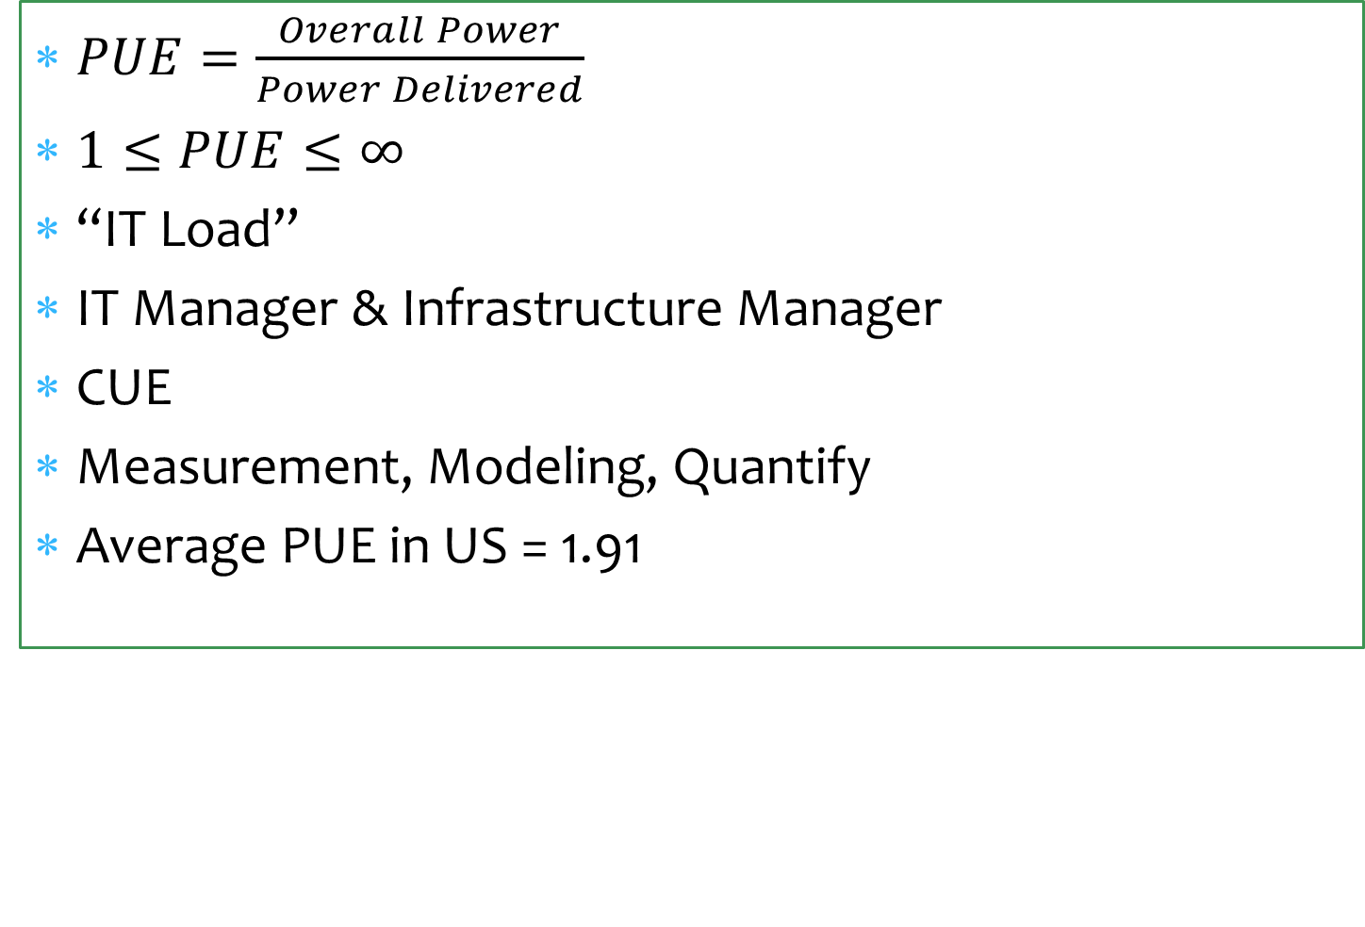
Power Usage Effectiveness(PUE)
Notes:
PUE Definition
Overall Power Drawn by the facility divided by the Power Delivered to the Data Centers.
PUE relates the total consumption of the installation with that considered essential to the service: the computer servers(IT Load).
It is the responsibility of the IT manager to reduce the consumption of IT load (renewing servers, virtualizing, etc.), and the
responsibility of the infrastructure manager to reduce the auxiliary consumption (more efficient equipment, free-cooling, etc.)
CUE –Carbon Usage Effectiveness
CUE defines CO2 emissions associated with the DC losses.

Slide 11
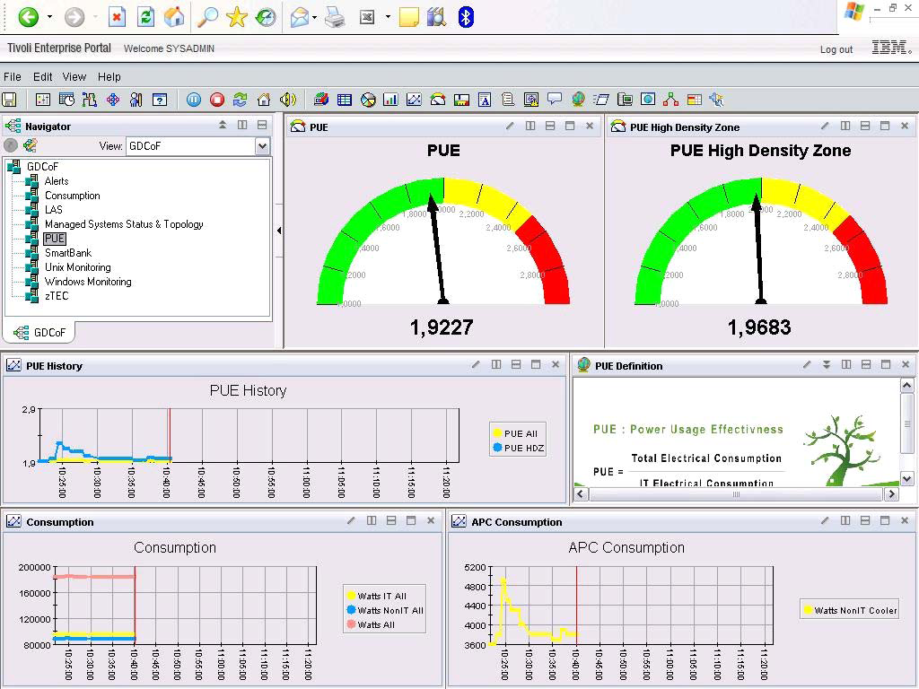
Notes:
Energy-Use Dashboards at Montpelier, France
The demo data center in Montpelier, France is called the PSSC (Products and Solutions Support Center) Green Data
Center of the Future. The main idea was to create a customer friendly real-time green showcase production data center that
will demonstrate a large percentage of the currently available best practices in IT and facilities energy conservation,
integrating at least one bleeding-edge major conservation technology. The information on the use of a live camera,
thermal camera, and green IT energy use real-time dashboards available to IT personnel through a portal are interesting
innovations that can help communicate the energy efficiency of the data center to all interested employees.
The Power Usage Effectiveness (PUE) is the metric used to measure the energy efficiency of a data center. Both IT and
non-IT resources’ energy consumption are gathered. Two PUEs are measured: overall and high-density zone.

Slide 12
Case Study of Senegal
UCAD Data Center
Campus Wide Backbone
Area occupied : - 60 square meters
Operates 24 hours a day
Servers : - 500 watts each
Green Data Center approach : - Racks
Cloud Computing involves : -
Workload Diversification
Power management flexibility
Low Power Processors in data centers : - Microsoft
Earth Rangers
Notes:
Workload diversification: Because many different sorts of users will be availing themselves of diverse cloud resources – different
applications, different feature set preferences and different usage volumes – this will improve hardware utilization and
therefore make better use of power that is being used anyway to keep a server up and running. 2. Power-management
flexibility: It is easier to manage virtual servers than physical servers from a power perspective. If hardware fails, the load
can automatically be deployed elsewhere. Likewise, in theory, all virtual loads could be moved to certain servers when loads
are light and power-down or idle those that are not being used.
Recent implementation of cloud computing - virtualization at a Canadian non-profit, Earth Rangers, demonstrated their ability to replace 4 racks of servers with ½ rack of servers and ½ rack of storage for their entire IT Operation.

Slide 13
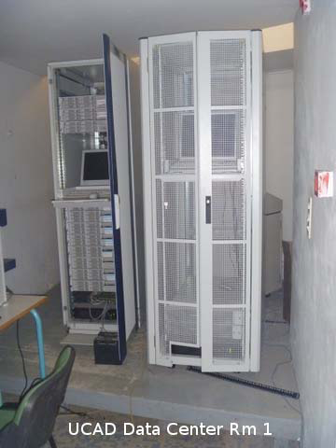
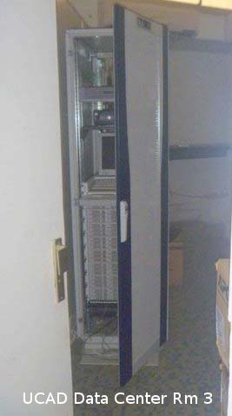
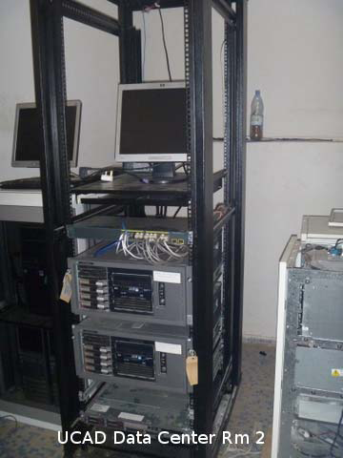
UCAD Data Center

Slide 14
Solar PV Array
Horizontal Approach : - “Rack” Design
Peak Daily Energy : - 23 KW
Normal Daily Usage : - 6.8 KW
Cloud Scheme : - Two Full Racks completely powered for 24/7
Area Required : - 1240 sq. feet
 | Switch Gear | UPS | PDU | IT Gear | Zone AC | Total
Green Cloud Rack | 0.05 | 0.08 | 0.05 | 0.6 | 0.2 | 0.98 KW
Current Data Centre- Racks | 0.1 | 0.5 | 0.9 | 9.8 | 4.5 | 15.7 KW

Slide 15
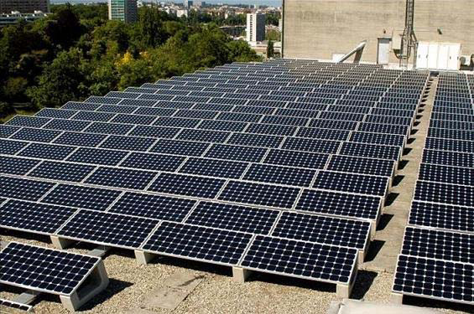
Rack Design

Slide 16
Case Study in South Africa
Cell Phone Company
Concerns : -
Test Environment Resource Availability
No good Scheduling Process
Server Waste
Private Cloud Designed
Benefits : -
Reduced time to test servers
Tight Scheduling
Reduced people resources
“Eliminates Cloud Security”
Reduced test server waste
Notes:
This case study is for a large cell phone company in South Africa. The cell phone company was experiencing very typical
concerns for large companies with their test and development environments.
There was significant amounts of test server waste due to lack of governance and management – for example
every project gets servers for testing and the servers were often not released when testing is completed
A private cloud was proposed to manage the company’s virtualized test environments. The private cloud was designed to provide tight governance around automated provisioning and de-commissioning of environments allocated to projects.

Slide 17
Case Study in South Africa
During 2010, the cell phone company’s South Africa IT landscape continued to increase in size and complexity, here is analysis of benefits to a cell phone company.
1100+ Server Instances
40% - 60% - estimated spend on maintaining current IT infrastructures versus adding new capabilities
87.03% avg .idle – The company has an average of 12.97% CPU usage across platforms – test is lower
Notes:
1100+ Server Instances – The number of instances has
grown exponentially over the past 5 years.

Slide 18
Case Study in South Africa
Bank in Johannesburg
Benefits : -
Speed: Test system setup that previously took two weeks now takes two hours.
Energy Savings: The bank reported a reduction of virtual servers by half, reducing power and cooling in half.
Conclusions : -
Incentive for IT h/w and s/w makers
To have better measurement facilities
Notes:
This case study for a bank in Johannesburg, South Africa
provided much of the incentive for the cell phone company
described above.

Slide 19
Indian Scenario
Green ICT Standardization in India : - GISFI
Started in 2010
Background info
High GHG emission
Fastest mobile subscriber growth rate
Erratic power supply
No network optimization
Solutions : -
To reduce carbon intensity by 20-25 % using fuel efficiency standards
Network deployment by developing energy efficient base stations

Slide 20
Indian Scenario
Data Centers:
As of 2007, 14% of all ICT emission is caused by Data Centers
Roughly 50% of the emission due to data centers is due to power system losses and cooling loads
Rapid Growth in use of IPTV, VOIP, enterprise IT
Use of both Corporate and Internet Data Centers.
Notes:
These are some of the facets of research concerning the Indian Scenario.
IPTV-IP Television
VOIP- Voice Over Internet Protocol

Slide 21
Go Green!!!
Examples mentioned will help in harnessing energy
Lots of research to be carried out
Maximizing Efficiency of Green Data Centers
Developing Regions to benefit the most
Notes:
Refer Conclusions & Future Scope

